Slide 1
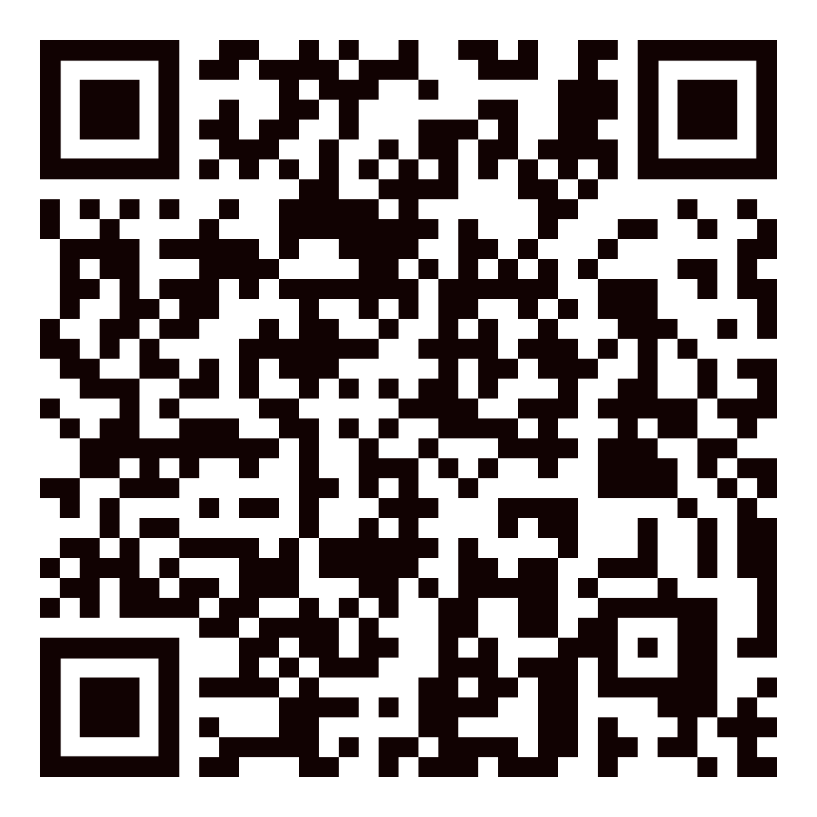
Good morning!
Welcome to
Spring 2024
Senate Retreat
Check out

Slide 2
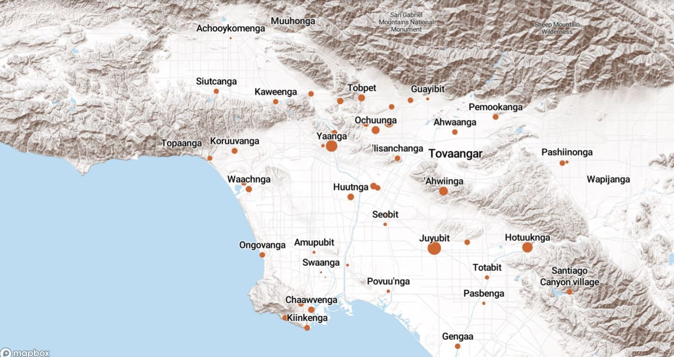
Land Acknowledgement
We acknowledge that the land on which Santa Ana College exists today is the ancestral land of the Tongva people, whose presence and resilience in Santa Ana continues to this day. We take this opportunity to honor the original caretakers of this land and recognize that histories of land theft, forced removal and assimilation, genocide, and erasure, and settler colonialism that have brought our institutions and ourselves here.
To acknowledge is not enough. This land acknowledgement is additionally a call to act, to consider our positionality and complicity in relations to these forces, and to engage in relationships and solidarity with the Tongva and other indigenous peoples.

Slide 3

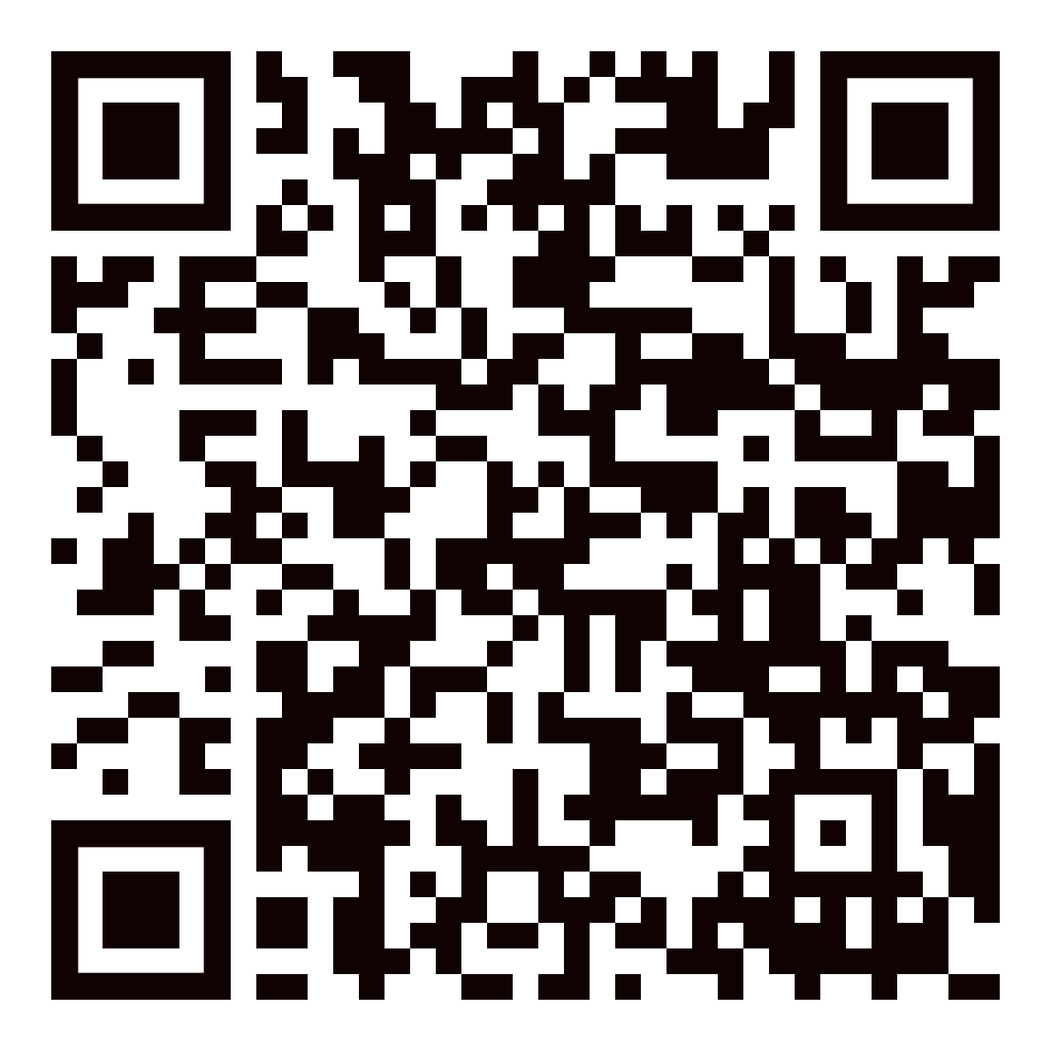
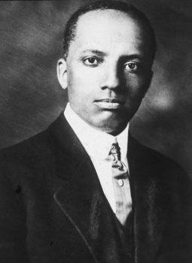

On February 7, 1926, Carter G. Woodson initiated the first Negro History Week to celebrate and raise awareness of Black history.

Slide 4

Today's Agenda
President's Update
Senate Business
Senate Committee Updates
  Curriculum and Instruction
  Distance Education Advisory Group
  Intersectionality, Race, and Social Justice Advisory Group
Faculty Discussion 1: Academic Integrity and Artificial Intelligence (AI)
Faculty Discussion 2:Academic Freedom
Senate Retreat Breakout: Course Maximum Workshop
Facilitated by: Suzanne Freeman, Amberly Chamberlain
1:00pm – 2:00pm in JSC-219

Slide 5
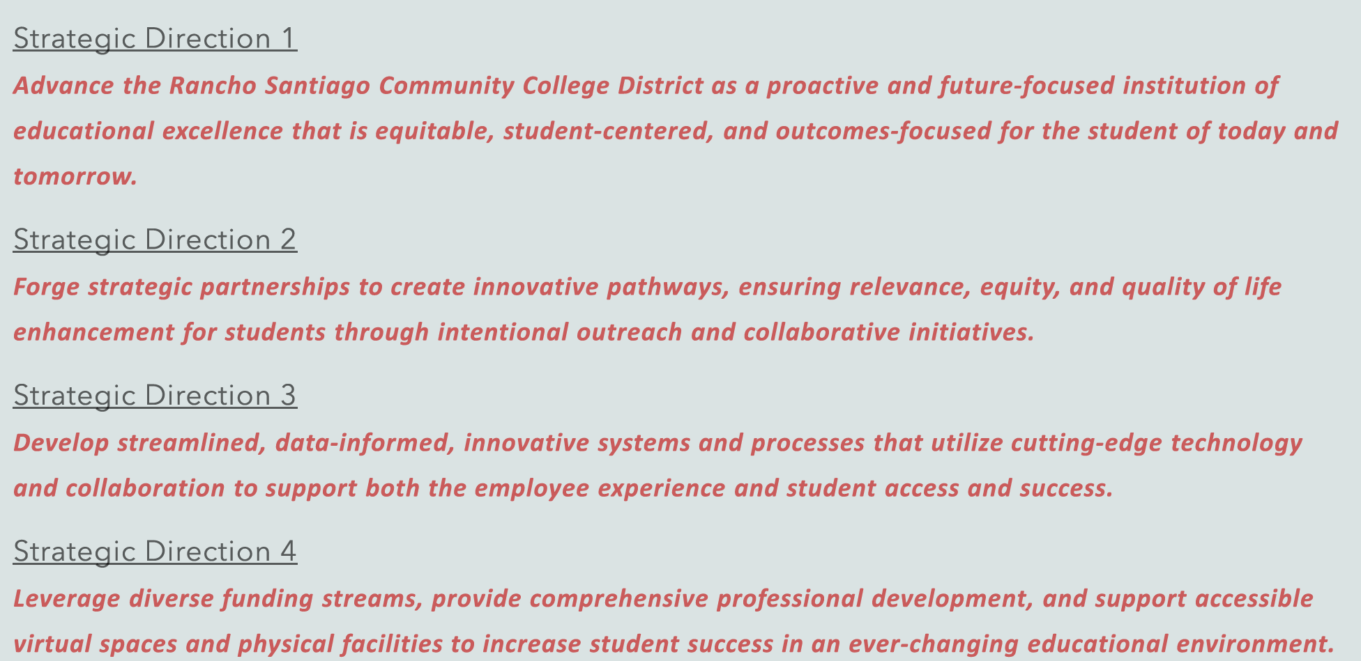
Senate President Update
Educational Master Plan Taskforce
122 Listening Sessions (~700 participants) & Presentations of Findings
January 17 District Planning and Organizational Effectiveness (POE) Retreat
    Established District Strategic Directions
Goal Planning Retreat: Feb 21-22, Joint Planning Session: Feb 23

Slide 6
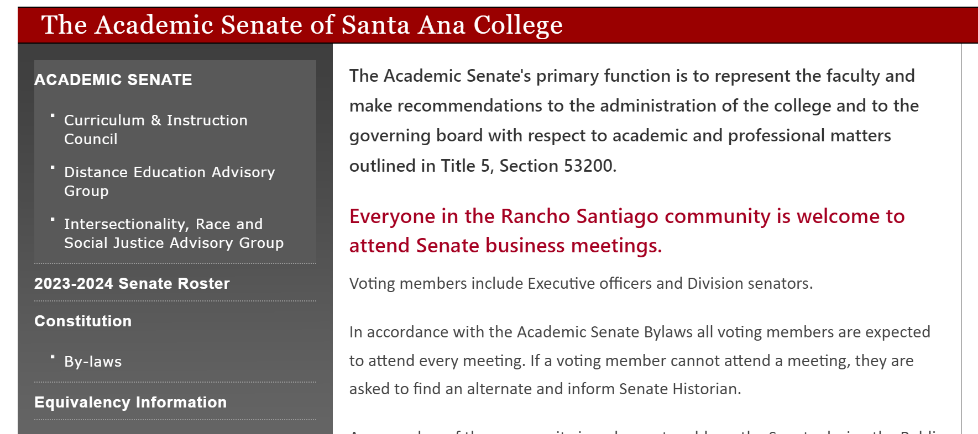

Hiring​
Job Announcements Posted​
Closing Dates
Counselors: Transfer and CTE: Feb 14
Ethnic Studies, Legal Studies, Pharm Tech: Feb 16
Counselor: Athletics: Feb 23
Chemistry: Feb 29​
Equivalencies: Do you have one?
Hiring Committees: Complete Interest Form

Slide 7

Participatory Governance & Institutional Service Opportunities
Scholarship Readers
  Reading Time Frame: 3/15 - 4/1
  Time Commitment: 4 – 8 hours total
  Sign up form shared soon
Credit for Prior Learning (CPL) workgroup
Outcomes Assessment Faculty Coordinator
Guided Pathways
Faculty Professional Development Committee
Joint SAC/SCC AI Workgroup
Sign Up Form Coming Next Week

Slide 8
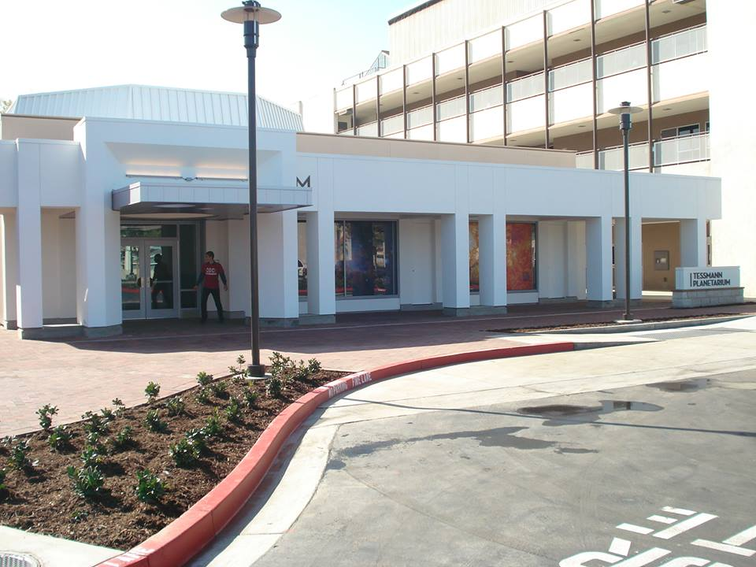
Facilities Updates
Russel Hall: Closed, To be demolished this semester, new entranceway
Tessman Planetarium: Closed, Demolish or Refurbish?
Major upgrades needed
Needs to be self-sustaining
Veteran's Resource Center: Relocated until Sept 2024
VRC Staff in JSC-208
Student Study Space is F-126
Hammond Hall: Elevator fixed

Slide 9
Dual Enrollment Update provided by Ashly Bootman, Co-Chair DuE Workgroup
Faculty Involvement Has Increased
    Review of CCAP agreements
    Creation of Subgroups (faculty onboarding, dual enrollment handbook, SAC internal policies and procedures, and student onboarding (including a possible noncredit counseling class to introduce students to dual enrollment)
Improvements
    Course Request Timeline
    Student Enrollment/Registration - Faculty authorization required after the first day of the semester
    Improved communication with HS Partners so less random course offering requests
Challenges Moving Forward
    2030 Vision – DuE starting with 9th grade
    Following intent of legislature
    Knowing which students are under 18
    Conforming to SAC Calendar/Contact Hours

Slide 10

President's Goals for Spring 2024
Complete Program Review for Academic Senate (by end of March)
Senate Taskforce that will review current Faculty Priorities process and those of other CC institutions, receive input from administrators and recommend changes to Faculty Priorities process for implementation in Fall 2025.

Slide 11
IdeazBoard
Colleague ShoutOuts - Share Some Words of Affirmation
Pros and Cons of AI in the Classroom
Open Forum Share Thoughts/Concerns/Issues You'd Like Addressed by Senate

Slide 12
Senator Duties
Of The SAC Academic Senate

Slide 13
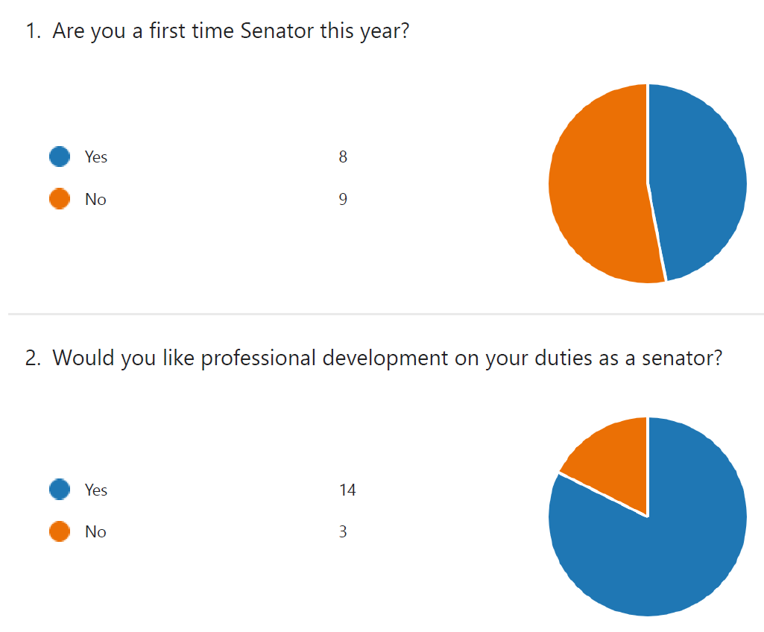
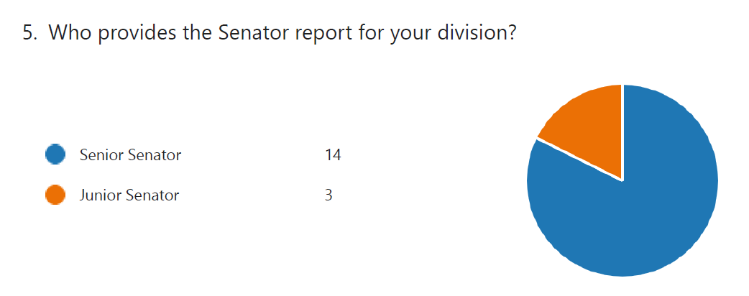
Survey Results

Slide 14
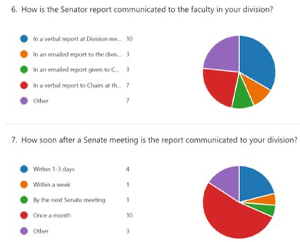
Survey Results

Slide 15
The primary responsibilities of Division and Adjunct Senators are to:
Regularly attend Academic Senate meetings.
Inform division faculty of Senate business in a regular and timely manner.
  Data shows this is mostly occurring once a month. It is encouraged to do so after each Senate meeting, especially for pressing matters.
Determine the will of their constituency and to vote and represent that view to the Senate, its officers, the division Deans, other academic Deans and to appropriate councils and committees.
  Hold special meetings/communications/surveys to determine your informed vote.
Approve faculty appointments to college shared governance committees and other appointed faculty positions.
  Hold special meetings/communications/surveys to determine your informed vote.

Slide 16
Obtain knowledge of and uphold 10+1 from Title 5 (RSCCD Board Policy 2410) and other pertinent Board Policy administrative regulations.
  A book and cheatsheet on Robert’s Rules have been provided to aid you in this capacity, as will PD training offered during the academic school year and meetings.
Inform new faculty within their constituent body (Senate Division or Adjunct Faculty) of the dues structure of the Senate.
Represent their division and/or departments during the annual faculty prioritization meeting when serving as Senior Senator.
  Hold special meetings/communications with department chair(s) to prepare presentation(s) on their behalf.
Manage their division and/or department Senate elections when serving as Junior Senator.

Slide 17
Serve, if elected in an even numbered year, as ex-officio members of their division's Department Chair Committee.
  In the case where an operational division is comprised of more than one Senate Division, all of the Senators within the operational division elected in even-numbered years will serve as ex-officio members of their operational division’s Department Chair Committee.
    E.g., the operational division of Humanities and Social Sciences is comprised of two Senate Divisions: 1. Humanities; 2. Social Sciences.
  The meetings of the Department Chair Committee will be attended by at least one of the ex-officio members.
    The attendee(s) may be determined on a rotating basis or any other method mutually agreed upon by the ex-officio members.
    The faculty co-chair of the Department Chair Committee will be elected by the committee members.

Slide 18
Division Senators elected in odd-numbered years will serve as ex-officio members of their division’s Curriculum Committee.
  In the case where an operational division is comprised of more than one Senate Division, all the Senators within the operational division elected in odd-numbered years will serve as ex-officio members of their operational division’s Curriculum Committee.
  The meetings of the Curriculum Committee will be attended by at least one of the ex-officio members.
    The attendee(s) may be determined on a rotating basis, or any other method mutually agreed upon by the ex-officio members.

Slide 19
  The faculty chair of the Curriculum Committee will be elected by the committee members.
    The two Senators within each Senate Division may exchange their membership duties between the Department Chair Committee and the Curriculum if the exchange is mutually agreed upon by both Senators.
    Such an exchange should be made before the beginning of the semester and should be reported to the Historian.
Call Division or Adjunct faculty meetings as appropriate during the year to inform and/or poll faculty.

Slide 20

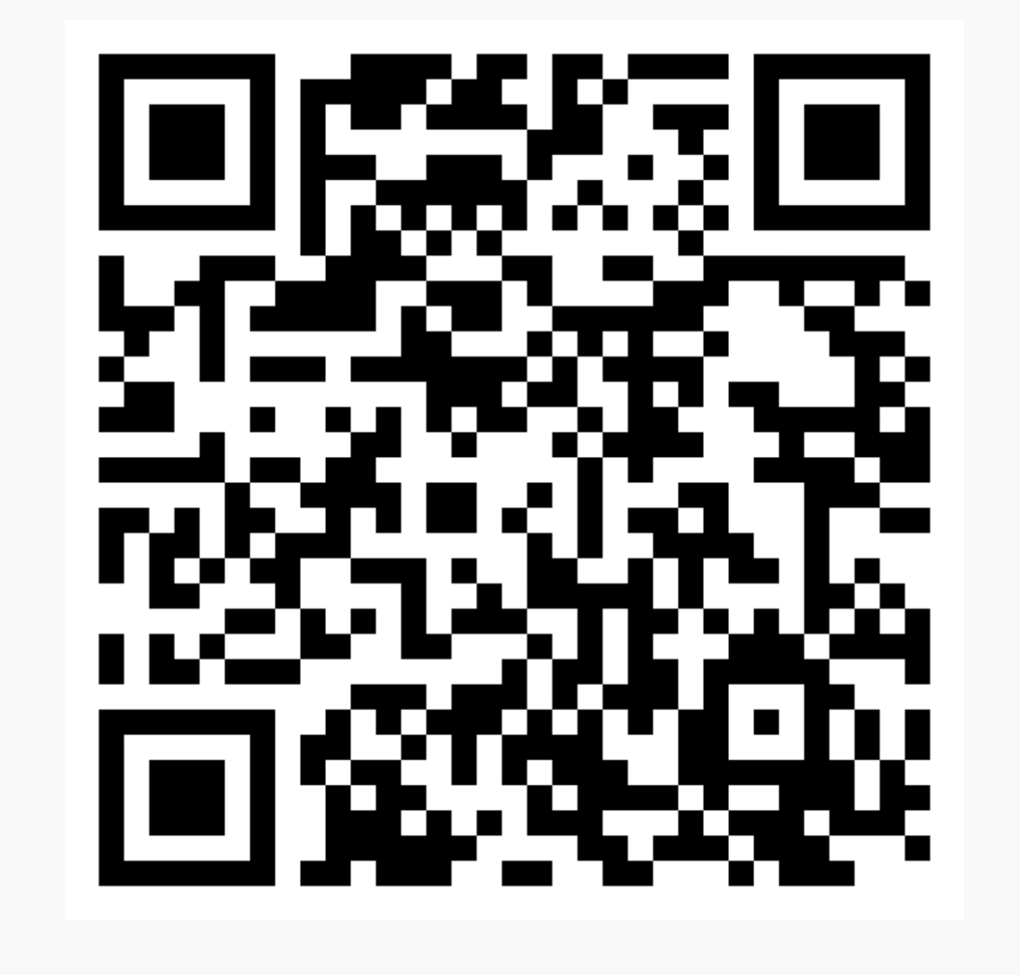
Academic Senate Dues
July 2023
84
January 2024
123

Slide 21

$1,000.00 donated in December 2023 ☺
Thrive Center donation

Slide 22

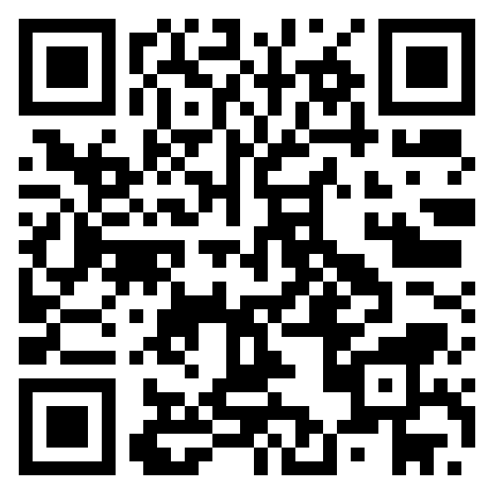

Slide 23

Awards of Excellence
Timeline:
Nominations close on February 20th
First taskforce convening week of February 20th
Decline or Accept to Nominees (by end of Feb)
Task Force meetings and selection of recipients by April 7th
Recipients notified and confirmed
Awards on May 1st

Slide 24
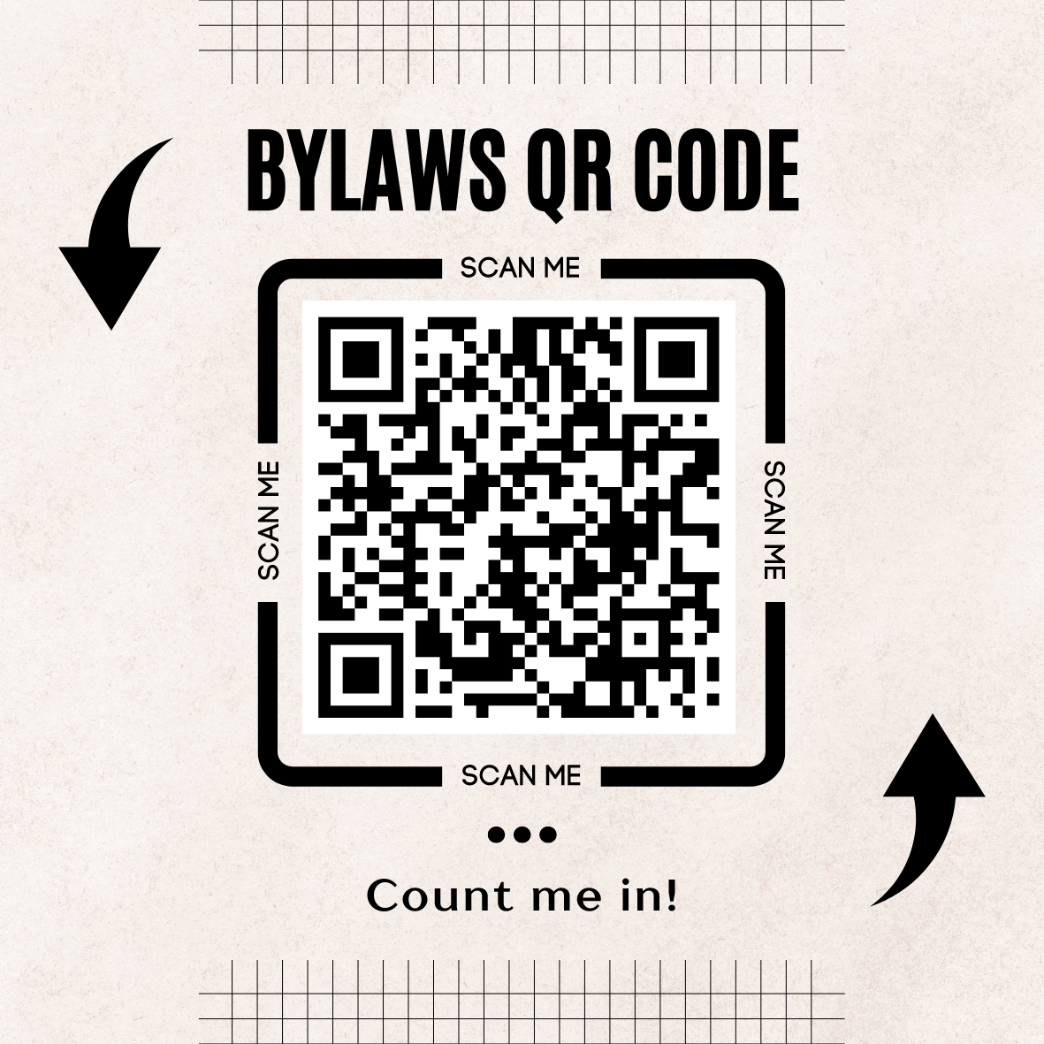
By-Laws Taskforce
We need to look at the by-laws and submit recommendations for edits/amendments by end of this term.
Interested in being part of the taskforce. Please complete the following our form by scanning the code here.

Slide 25
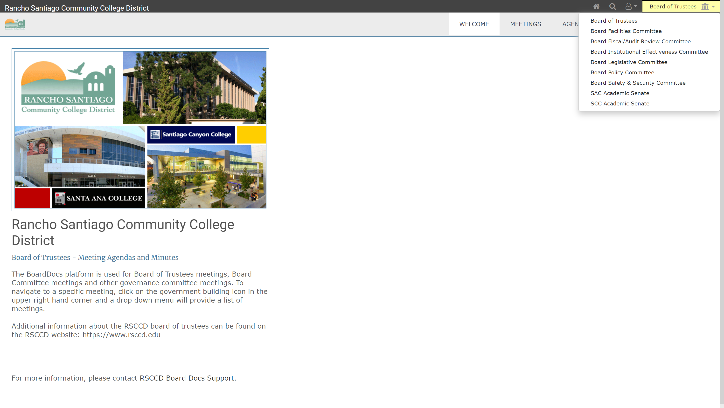

BoardDocs: Access Through District Website
STEP 1: Trustees dropdown menu on district site
STEP 2: BoardDocs dropdown menu to select SAC Academic Senate

Slide 26
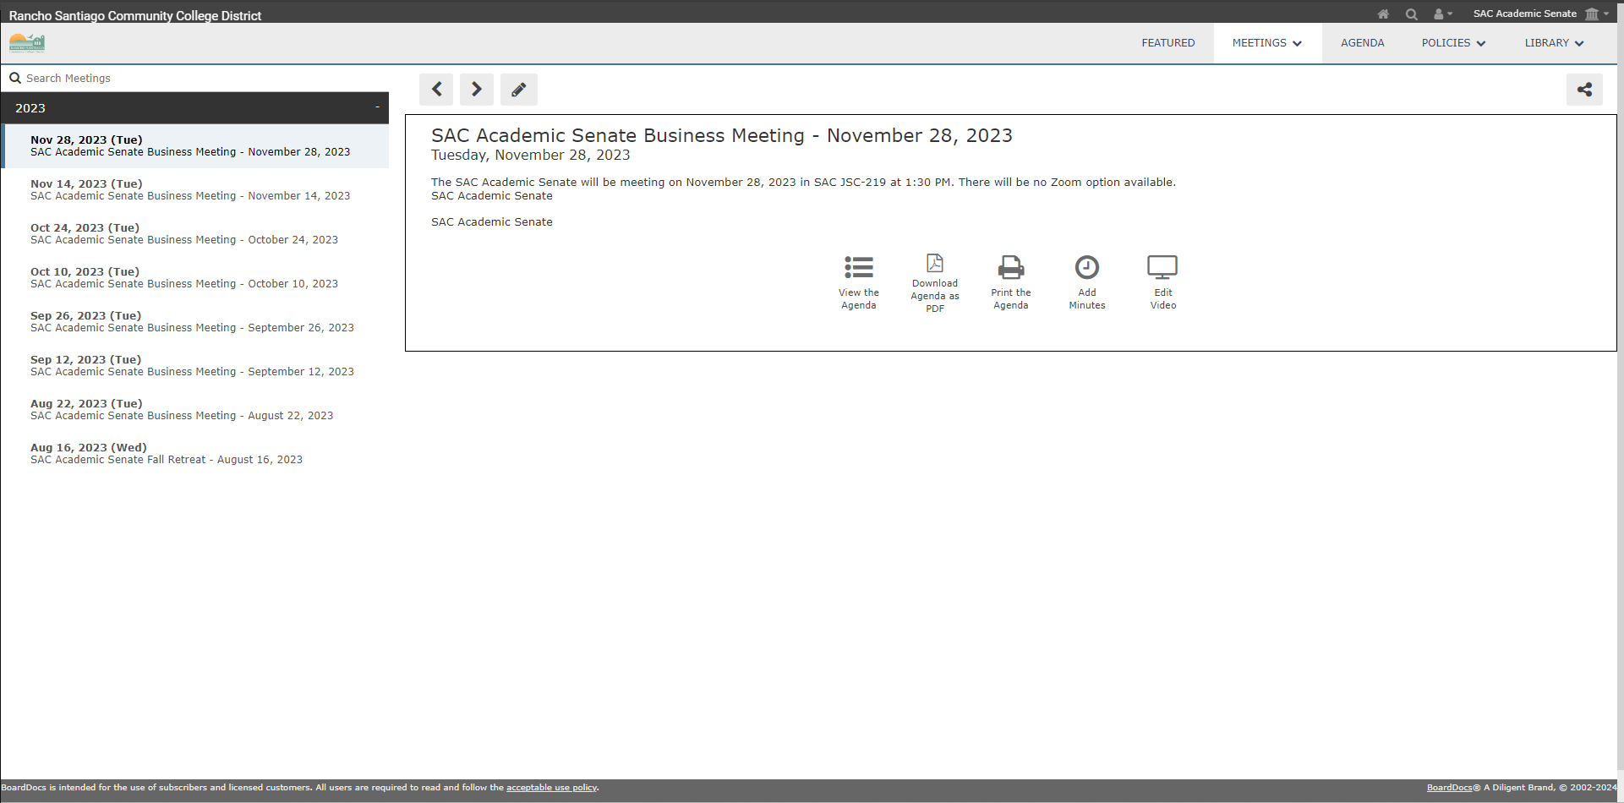
BoardDocs: Meetings
Info / options for each meeting
List of meetings

Slide 27
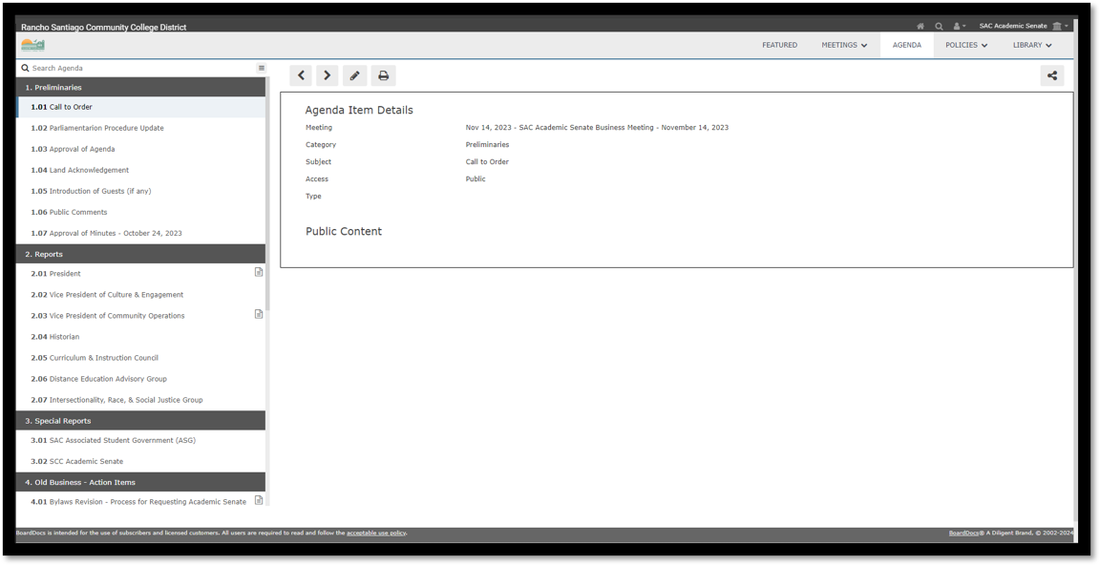
BoardDocs: Agenda
Files for topics
Info for item

Slide 28
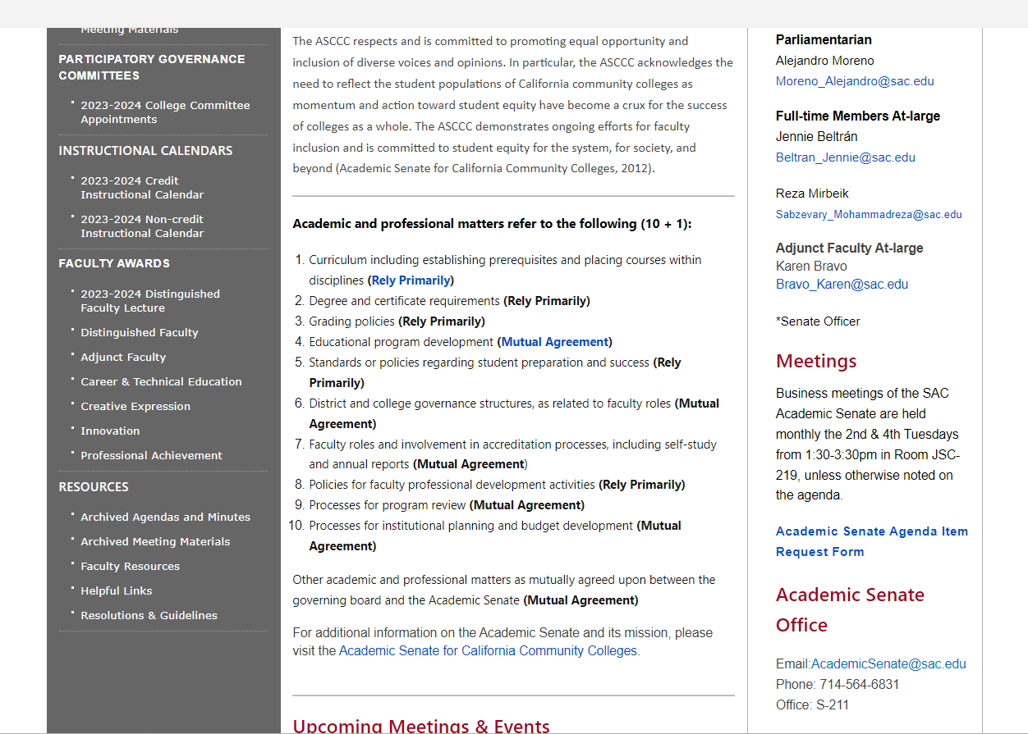
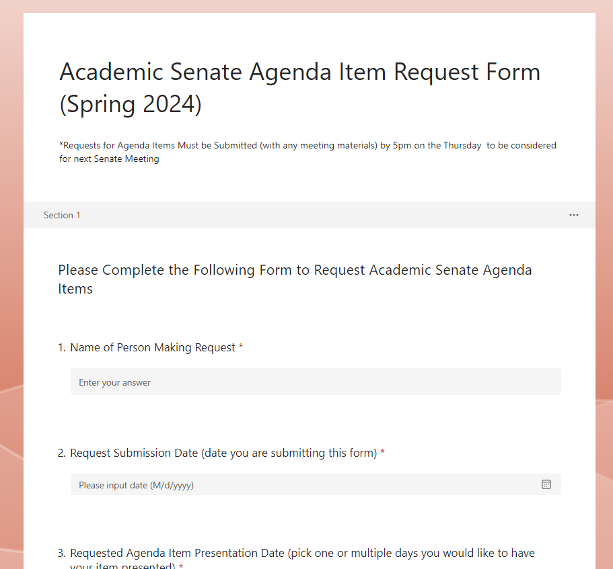
Requesting Agenda Items

Slide 29

Governor’s FY 2024-25 Proposed Budget
Board of Trustees Meeting
January 16, 2024
Presented by: Iris Ingram, Vice Chancellor, Business Services

Slide 30

Legislative Analyst Office Version
State facing a $68B deficit​
Prior year revenue shortfall in 2022-23 ($26B below estimate)​
Why the shortfall? ​
  Delayed tax deadlines (April to November) pushed news of revenue shortfall to after close of fiscal year 22-23​
  Weather-related (wild fires and floods) losses to state businesses and residents​
  Inflation reduced State’s spending power through increased cost of borrowing (interest rates)​
  Reduced economic activity​ (home sales, business start ups, IPOs, increase in unemployment rate)
Tools to address budget gap​
  Use of reserves ($24B)​
  Spending reductions likely ​to education ($17B)​
  One time expenditure cuts ($10B)​
  Cost shifts between fiscal years​
  ​
  Relatively few options​
    Use of reserves​
      Not sufficient to cover multi-year deficits ($30B per year)​
    Cost shifting among fiscal years​
    Use of one-time dollars​

Slide 31
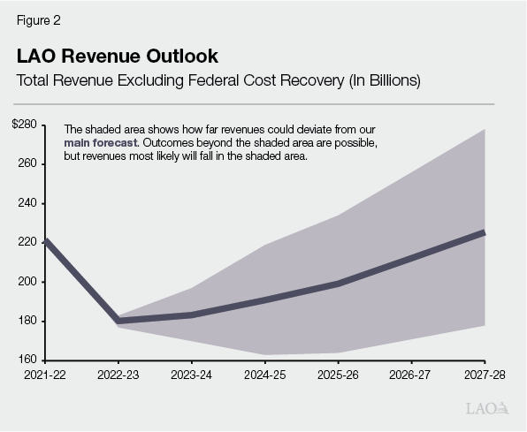
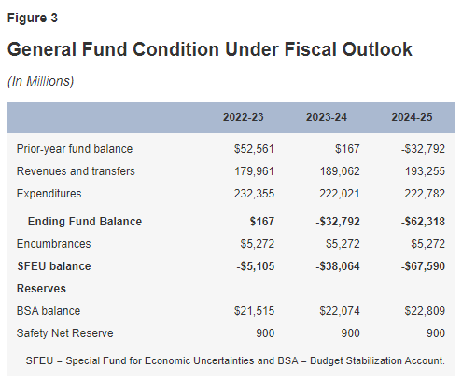

Legislative Analyst’s Projections

Slide 32
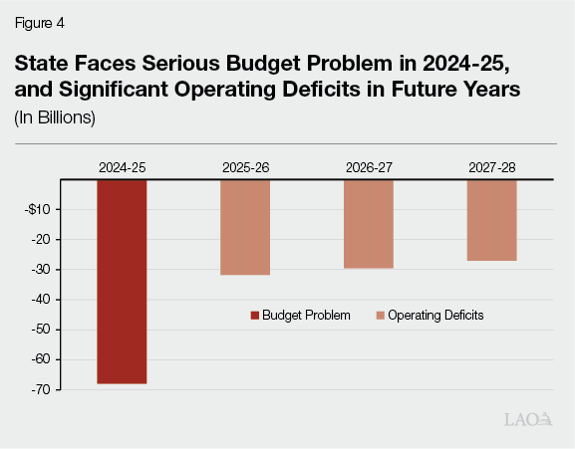

Options for Budget Deficits
Draw down Reserves
  $24B available
  Requires declaration of a “budget emergency”
Reduce Prop 98 spending
  Cuts to K-14
Reduce other One-time Spending
Source: LAO, The 2024-25 Budget, California’s Fiscal Outlook

Slide 33
Governor’s 2024-25 Budget Proposal
Presented a balanced budget of $291.5B
  General Fund budget of $208.7B
  Budget shortfall of $37.86B
Continues the following priorities “Promises Kept”
  $15.3B for Homelessness Programs
  $8.7B for Mental Health Programs
  $1.1B (over 4 years) for Public Safety
  $109.1B (Prop 98) for Career Education
    UC system - $273.3M
    CSU system - $240.2M
  $58B for Climate Initiatives

Slide 34
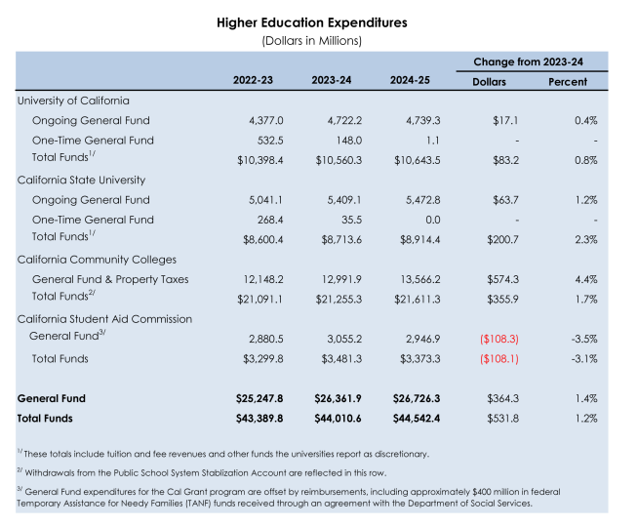
Proposal for Higher Education
Source: 2024-25 Governor’s Budget Summary

Slide 35
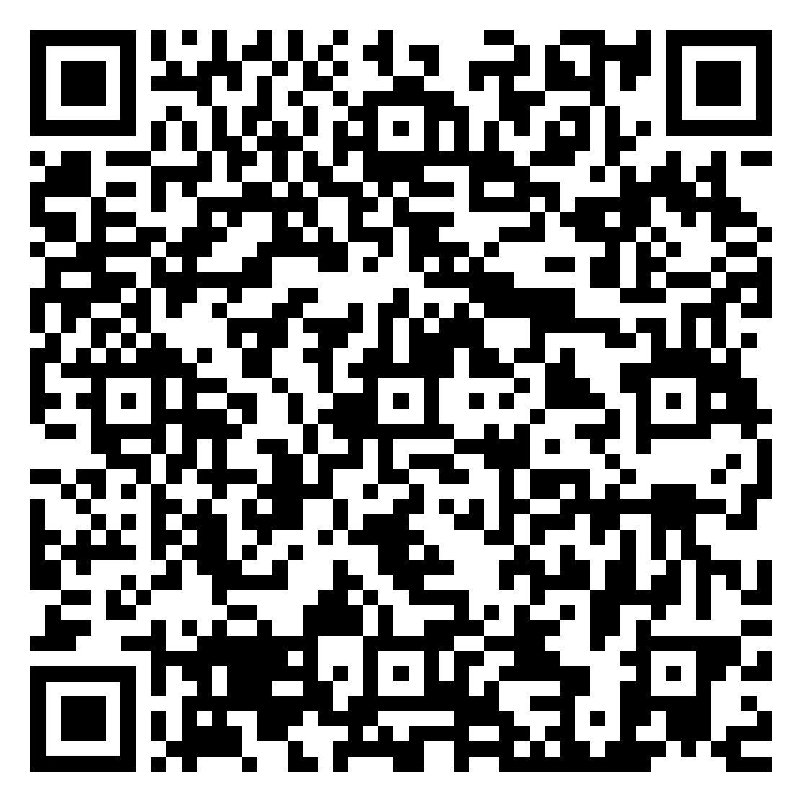
Community College Proposal
Continued focus on the multi-year roadmap
  Equity
  Student success
  Preparing students for the future
COLA of 0.76% to SCFF or $69.1M
Growth of 0.5% or $29.6M
Select Categorical programs and Adult Education will receive a COLA of $9.3M or 0.76%
Drawdown from Reserves (School Rainy Day Fund) of $235.9M in 2023-24 and $486.2M in 2024-25 to support the SCFF.
Increase of $60M one-time Prop 98 funds to expand nursing programs
Continues support for Student Housing through Lease Revenue Bonds, but pulls back $300M in one-time General Fund appropriations for 2024-25 to 2028-29
SCFF = Student Centered Funding Formula

Slide 36
What’s Next?
Hearings and meetings in February – March
  Senate Budget Subcommittee
  Assembly Budget Subcommittee
May Revise
June 10, 2024 -Tentative Budget approval by RSCCD Board of Trustees
June 17, 2024 - deadline for Legislature to approve State Budget

Slide 37
Curriculum
& Instruction
Council
Chair Report
Academic Senate Retreat
Spring 2024
Madeline Grant

Slide 38
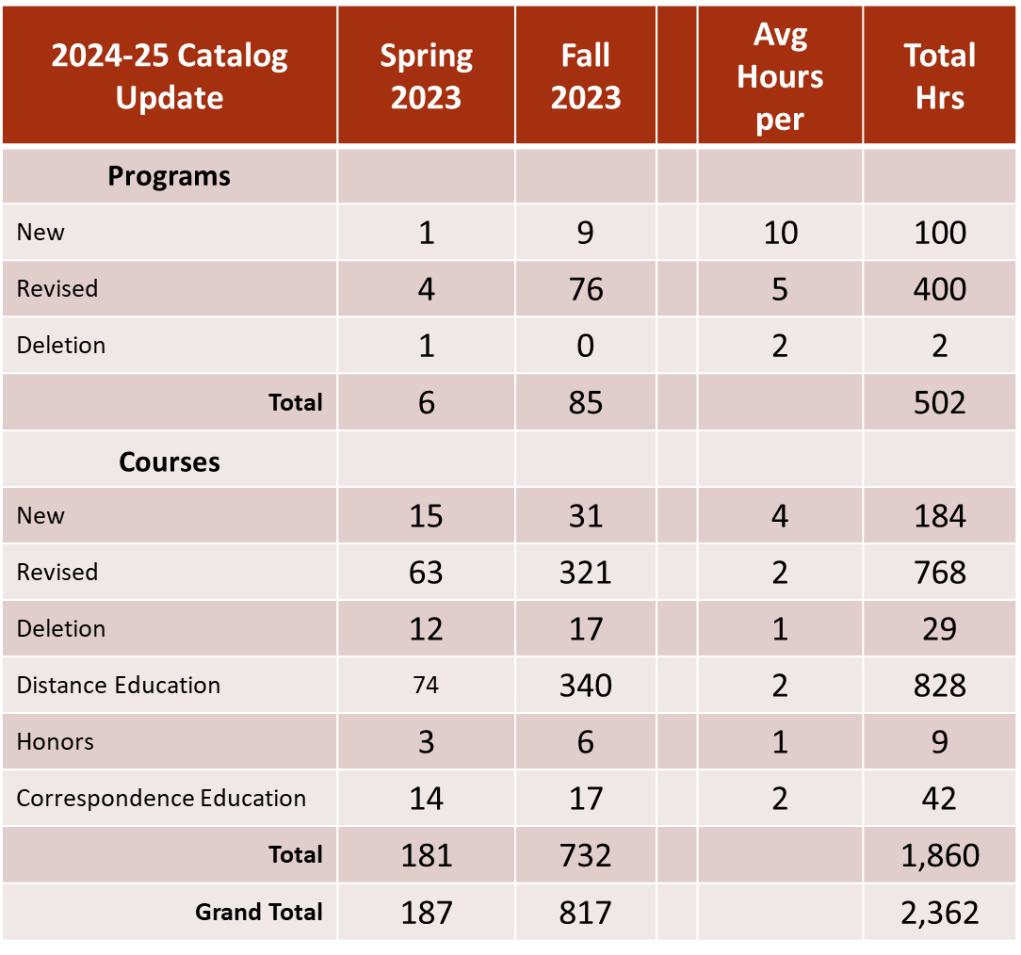
2023 Recap
Presented to Board of Trustees on Dec 12, 2023

Slide 39
CIC Workgroups Update
  Gen Ed Review (AB 928/CalGETC & Plan A)
    Plan A – Update Required
      PD Week Mtg held on Monday
      Next Meeting: Feb 29, 1:30 – 2:30
    CalGETC – Implementation Fall 2025
  Course Enrollment Maximum –
      Sub groups established (Lecture classes, Lab/Performance/Production classes, Implementation)
      Next Meeting: Today 1:00
  Work Experience
    Fall 2023 – CORs updated for 2024 Catalog
    Spring 2024 – AR revisions & development of required documents
  Catalog Workgroup
      Led by Kristen Robinson & Sara Butler
  Program Mapping
    Led by Kristen Robinson & Sara Butler

Slide 40
Curriculum Training
  Canvas Shell Requested for Curriculum
  May Replace Curriculum Handbook
  Developing Canvas Shell layout & content areas now
  Goals:
    Have Canvas Structure & copy completed End of Spring 2024
    Develop Training Videos and Screen shots Summer 2024
  Need:
    1 – 2 additional faculty interested in the project.
    Must have Curriculum, Canvas and Video experience/knowledge

Slide 41
Gen Ed Plan A
Update
§ 55061. Associate Degree Course Requirements
(c) A minimum of 21 semester units (28 – 31.5 quarter units) of general education in the areas
described below.
(1) English Composition, Oral Communication, and Critical Thinking (minimum of 6 semester) including:
(A) English Composition (minimum of 3 semester).
(B) Oral Communication and Critical Thinking (minimum of 3 semester).
(2) Mathematical Concepts and Quantitative Reasoning (minimum of 3 semester)
(3) Arts and Humanities (minimum of 3 semester). Visual and performing arts, art history, foreign languages, literature, philosophy, religion, and related disciplines.
(4) Social and Behavioral Sciences (minimum of 3 semester). Cultural anthropology, cultural geography, economics, history, political science, psychology, sociology, and related disciplines.
(5) Natural Sciences (minimum of 3 semester). Astronomy, biology, chemistry, general physical science, geology, meteorology, oceanography, physical geography, physical anthropology, physics, and other scientific disciplines.
(6) Ethnic Studies (minimum of 3 semester). Ethnic Studies: Black Studies; African American Studies; Africana Studies; Native American Studies; Chicano/a/x; Latino/a/x Studies/La Raza Studies; and Asian American Studies

Slide 42
Current Situation
Plan A (2023-24 Catalog)
  Shared categories with SCC
  Classes in each Category determined locally
    Must ensure shared courses are in the same categories.
  Currently Plan A is “27” units (including proficiencies & requirements)

Slide 43
Questions to Answer
Course Categories
  Do we keep our existing categories and align new regs to us?
  Do we transition our categories and utilize Title 5 Categories?
    Impact on Colleague, Meta, Degree Audit, Portability for Students, etc.
Unit Requirements
  Do we increase to 30 Units (keep existing 27 + Ethnic Studies)?
  Do we maintain 27 units and eliminate a requirement to account for Ethnic Studies ? If so what is eliminated?
  Do we decrease our requirements to minimum of 21 units?
Plan D
  If we maintain 27 units or increase to 30 units – do we create a Plan D Gen Ed Option (e.g. 21 units) for high unit degrees (e.g. Nursing)?

Slide 44
Questions to Answer
Course Requirements
  How can we realign courses currently offered as Gen Ed into the required categories?
  Which courses are maintained & which courses are deleted?
  If we maintain current SAC Categories (not in Title 5), what will the criteria for course approval be to include courses in these categories?
Timeline
  Do we implement for 2024-25 catalog ?
  Do we implement for 2025-26 catalog?

Slide 45
Gen Ed Plan A
Update
  Goals:
    Timeline Decision by February 29th Meeting
    Presentation to CIC on March 11
    Initiate SAC work to meeting agreed upon timeline
    Begin dialogue with SCC
  Need:
    Department Chairs –
      Include this topic in your Dept. Meetings TOMORROW
      Make time and space to discuss the timeline & other questions in your department
    Identify a faculty Representative from each department with Classes in Plan A to report to the workgroup

Slide 46
IdeazBoard
Colleague ShoutOuts - Share Some Words of Affirmation
Pros and Cons of AI in the Classroom
Open Forum Share Thoughts/Concerns/Issues You'd Like Addressed by Senate

Slide 47
Distance Education Report 02/06/24

Slide 48
Updates:
Canvas Impact is active
PopeTech Accessibility Dashboard available
Update from CVC:
  106 Quality Reviewed Courses
  RSCCD most enrollments of any district
  Nominated for recognition/award at the CISOA Conference
Updated and enhanced Canvas Faculty Training

Slide 49
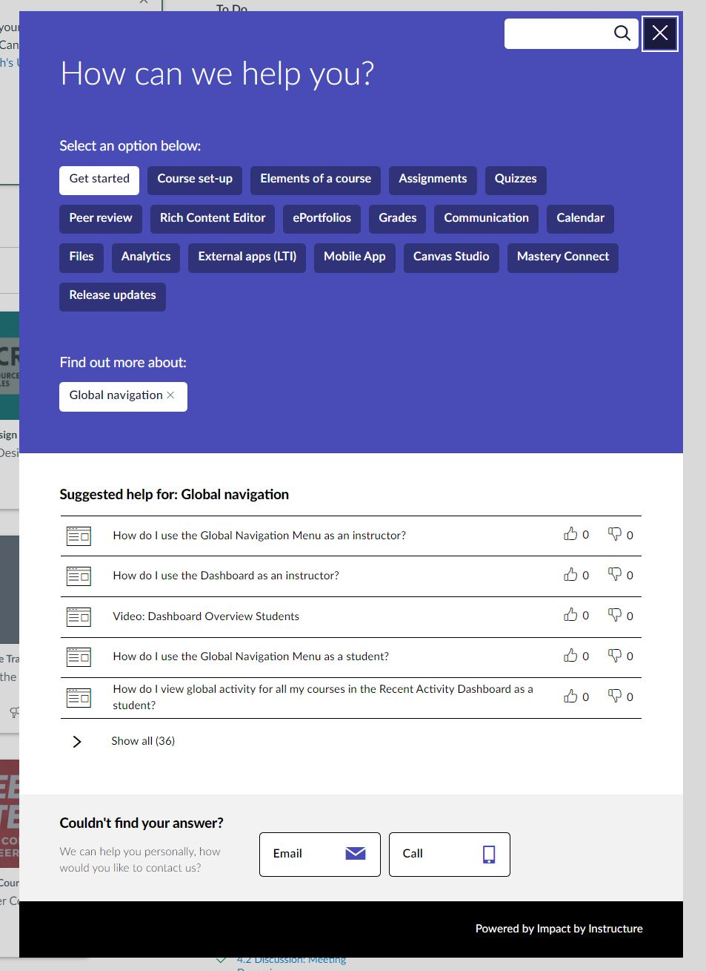
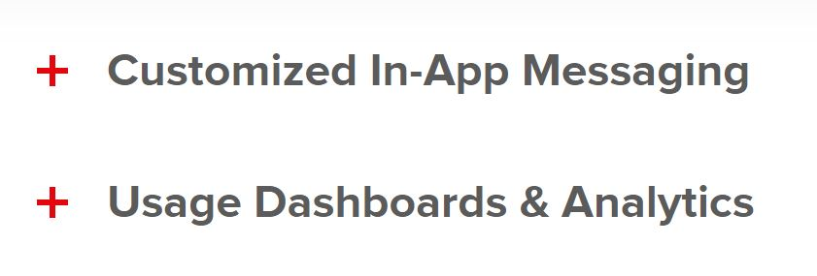



Canvas Impact

Slide 50
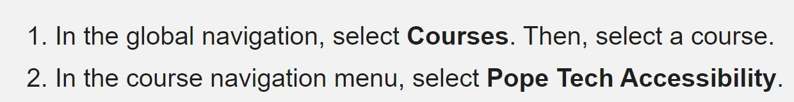
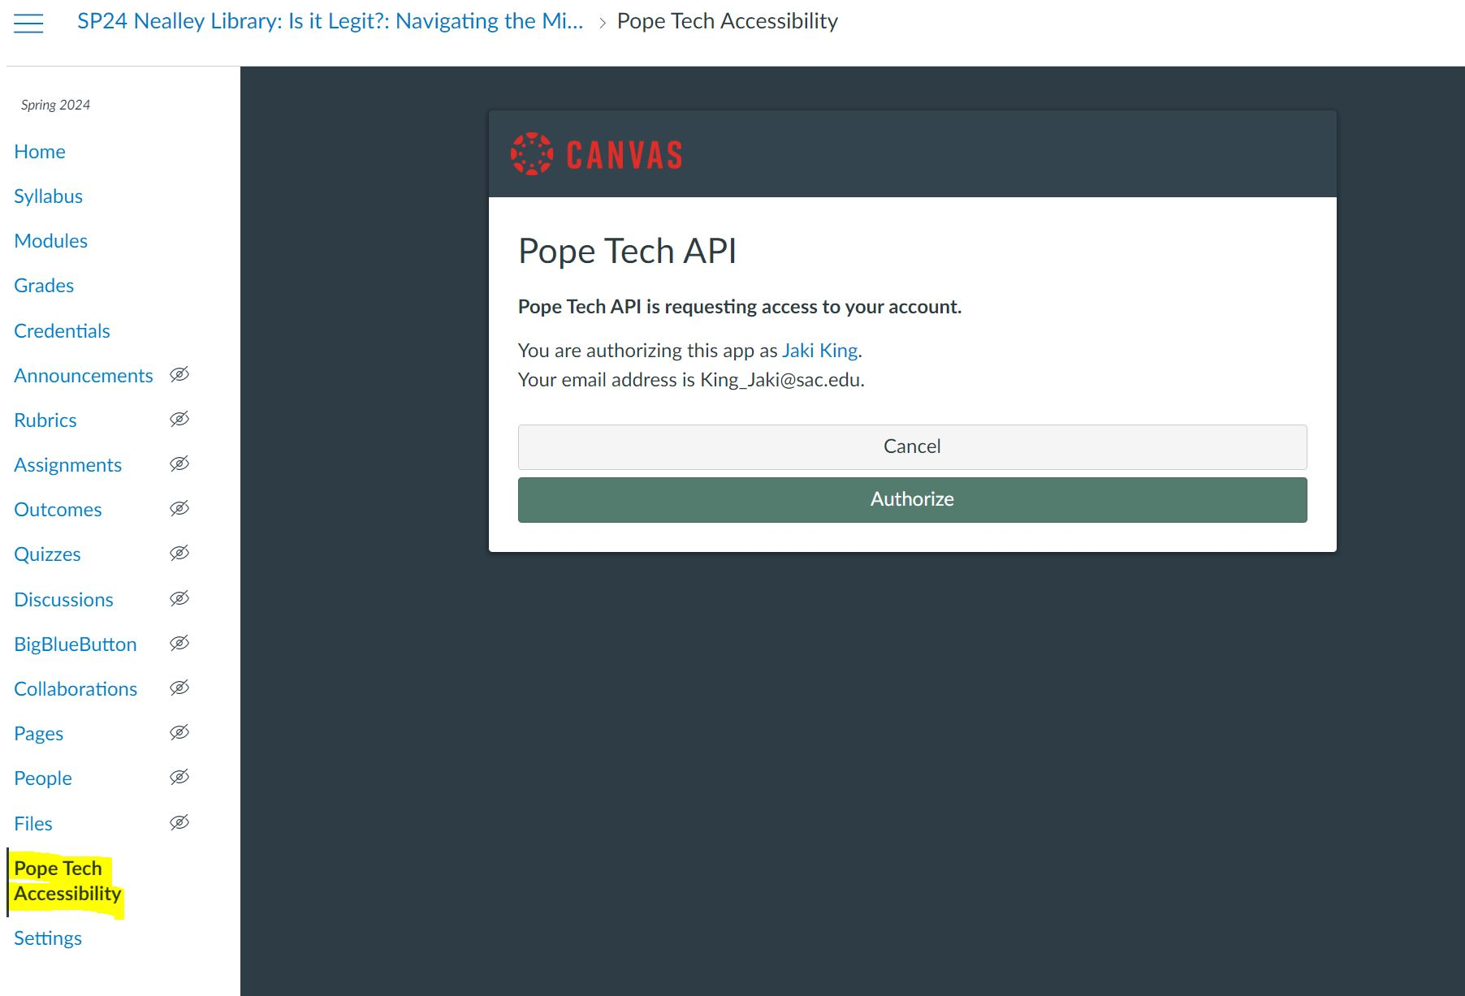
PopeTech Accessibility
PopeTech Information

Slide 51
Update from CVC
  Rancho Santiago CCD has the most enrollments of any district, despite only launching in fall 2022. As of summer 2023, RSCCD had 1,177 cross enrollments. Foothill - De Anza CCD, which went live a year prior, comes in second with 1,006 cross-enrollments.
  Since fall 2020, the CVC Exchange has had more than 100,000 online class sections available for enrollment in the CVC Exchange during the start of each term. More than 75% of these online classes are badged for course quality, online tutoring, and/or Zero Textbook Cost.
  During the 2022-23 academic year, the most searched course by keyword was calculus, followed by physics and statistics. More than 24,250 students searched for online sections of calculus, while 16,565 searched for physics and 11,426 for statistics.
  The only non-GE subject to make the top 20 was real estate with 5,729 searches. The most searched general education requirement is ethnic studies, with more than 1,300 students searching for it since summer 2022.

Slide 52
RSCCD nominated by CVC to CISOA
After conferring with the CVC team, we'd like to nominate the Rancho Santiago CCD for a recognition. Specifically, they've done a great job with the following:
They are responsive to internal process changes to make etranscripts more student-centered. Meaning, during the process of implementations when they encountered problematic business processes that were not student-friendly, they did the work to update and change those.
They are very supportive of post-implementation updates, pilots and other needs.
They champion the use of the CVC Exchange throughout their district, and have also made concerted efforts to add more online STEM courses, particularly in math. They also did a board presentation on the Exchange and are good about informing their stakeholders about their engagement.
They are a good system-wide leader in that they created a slidedeck for us about their "lessons learned" during implementations and have even offered to answer questions from other colleges who may have similar ERPs/structures.
The two colleges do an excellent job of intentionally using the Exchange for strategic enrollment management and enrollment recovery, and as a result have been a top "earner" in terms of their presence and enrollments through the Exchange.

Slide 53
Thank you!

Slide 54
Break Time!
Be sure to post to IdeazBoard!!

Slide 55
Faculty Discussion 1: Academic Integrity & Artificial Intelligence (AI)
How familiar are you with the various AI tools and technologies that students may use for academic tasks?
Pros and Cons of AI
How we can address AI and Academic Integrity in our courses?
Recommendations?

Slide 56
Faculty Discussion 2: Academic Freedom
Working in Groups of 3-4 Review Proposed Language and provide feedback

